Slide 1
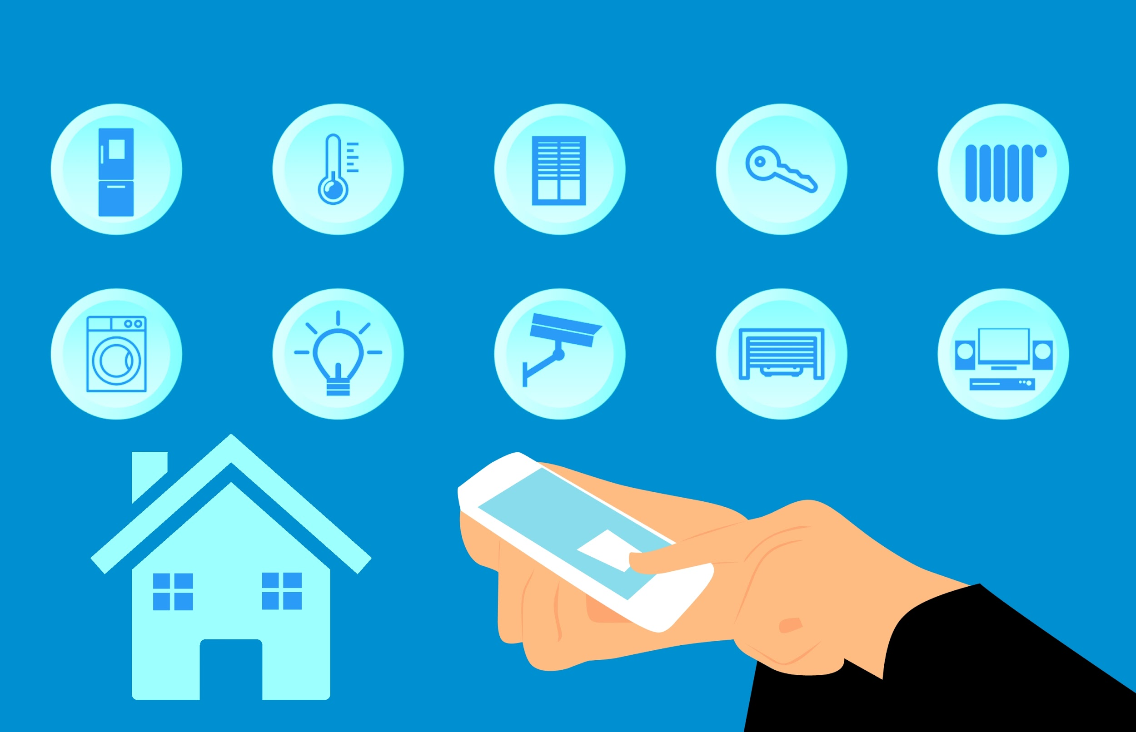
IOT BASED
System For
Smart City
Abhinandan Raj (510819042)
Abhishek Gupta (510819045)
Prakash Kumar (510819098)
Mentored by: Prasun Ghosal Sir

Slide 2
Acknowledgement
I would like to express my special thanks of gratitude to my professor Prasun Ghosal Sir as well as our HOD sir who gave us the golden opportunity to do this wonderful project on the topic IOT Based System for Smart City, which also helped me in doing a lot of Research and i came to know about so many new things I am really thankful to them.
Secondly i would also like to thank my parents and friends who helped me a lot in finalizing this project within the limited time frame.
Date: 04 June 2021 Prakash Kumar
Abhinandan Raj
Abhishek Gupta

Slide 3
Contents
Existing Problems
Introduction
What is Home Automation?
Devices Used
Software Used
How it works?
Applications
Advantages
Disadvantages
Scope
DEMO
Conclusion
Reference

Slide 4
Existing Problems
People are generally outside the home for many reasons like travelling and they want to control some devices from a far distance.
Example:
Turn on the AC before they reach home.
Water their plants.
Want to turn off the lights and windows if they forgot .
Total control of the home.
Check whether we locked the door or not.

Slide 5
INTRODUCTION
~ There is an increasing demand for smart homes , where appliances react automatically to changing environmental conditions through one common device.
~ This project presents a possible solution whereby the user controls devices by using their existing mobile phone , where control is communicated to the micro-controller from a mobile phone through wi-fi interface.

Slide 6
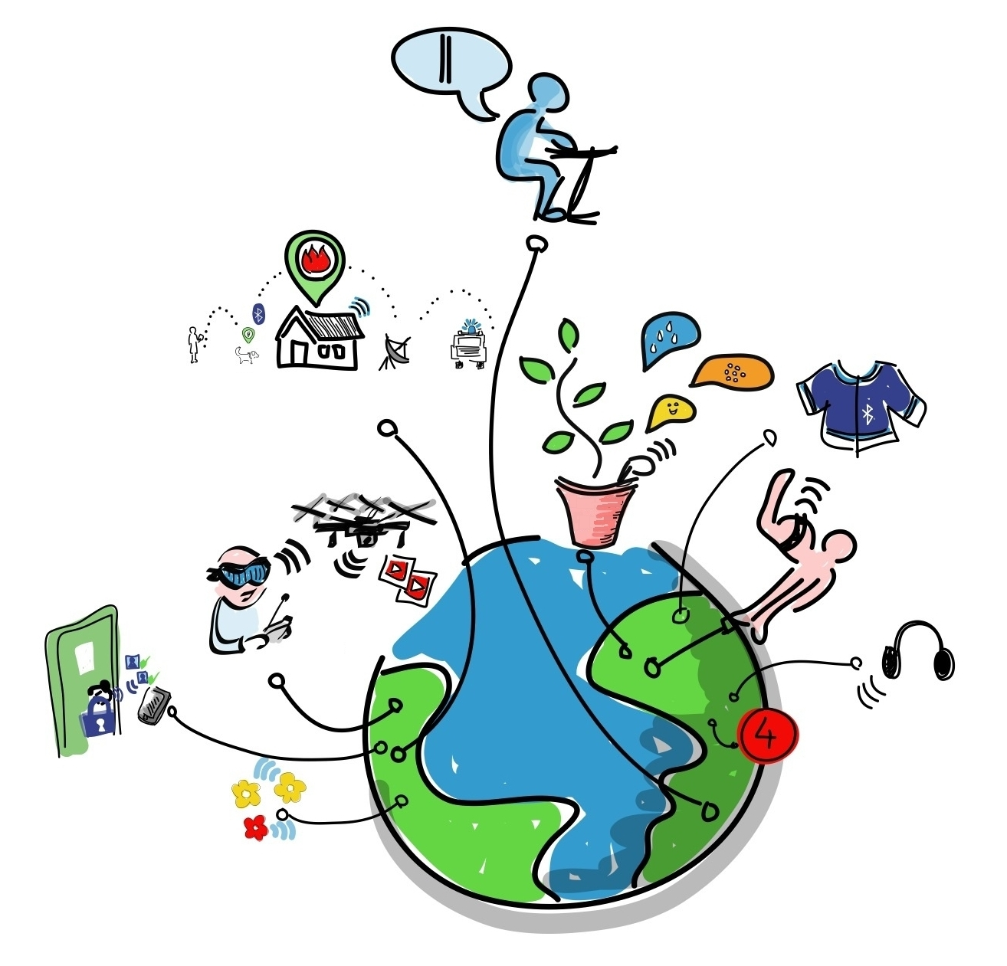
What is Home Automation ?
~ Home automation involves introducing a degree of computerized or automatic control to certain electrical and electronics system in a building.
~ These lighting, temperature control , etc. This paper demonstrate a simple home automation system which contains a remote mobile host controller and several client module(home appliances).
~ The client modules communicate with host controllers through a wireless device such as an android based smart phone.

Slide 7
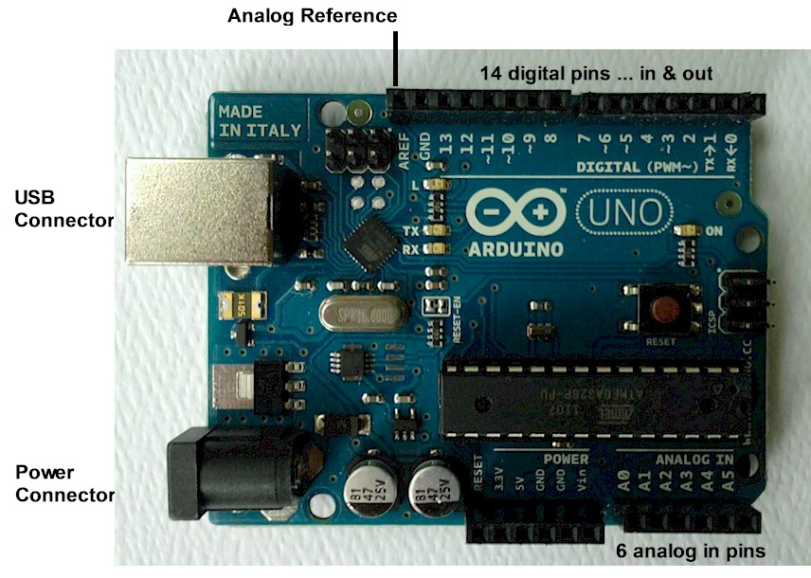

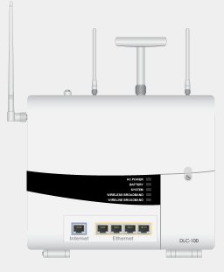
Devices Used
Cable modem
MCU (microcontroller unit)
Home Gateway

Slide 8
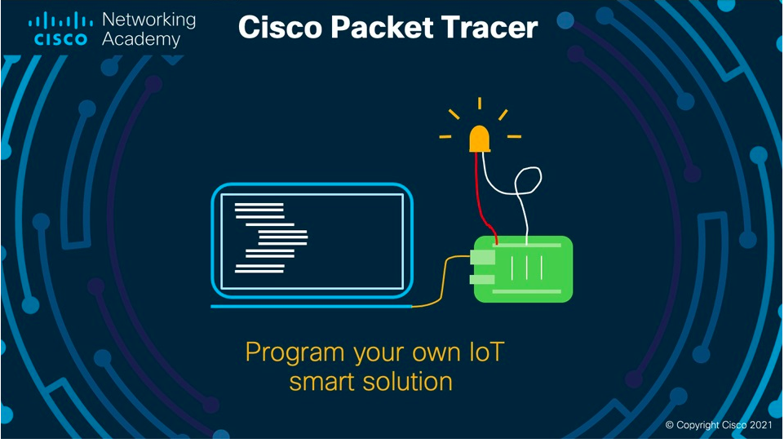
Software Used
Version 8.0.0

Slide 9
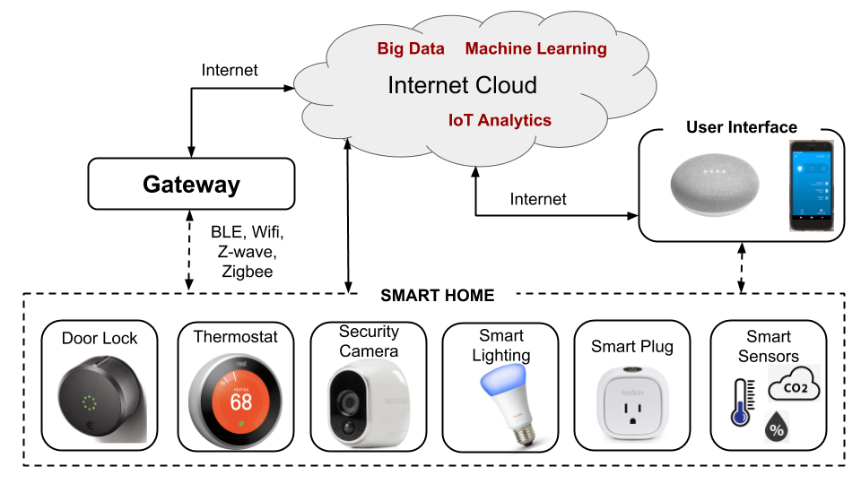
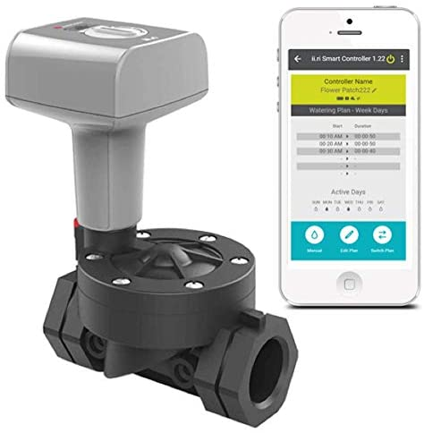
How it works?
Smart sprinkler

Slide 10
Applications
Lawn Irrigation System
Security System
HVAC (Heating, Ventilation and Air Conditioning) Regulation
Smart Appliances
Air Quality Monitoring
Better Infotainment Delivery

Slide 11
Advantages :
Remote access
Comfort
Convenience
Increased safety
Energy efficiency

Slide 12
Disadvantages :
Hacking problem
The cost of investment
Reliance on an internet connection
Rewiring older homes

Slide 13
Scope
Home security goes wireless.
Voice command automation.
New era in energy management.

Slide 14



Slide 15
Conclusion :
~ Home automation is undeniably a resource which can make a home environment automated. People can control their electrical devices via these home automation devices and set up controlling actions through mobile.
~ In future this project may have high potential for marketing.

Slide 16
References
https://en.wikipedia.org/wiki/Home_automation
https://www.netacad.com/courses/packet-tracer
https://community.cisco.com/t5/switching/packet-tracer-help/td-p/3070170
https://create.arduino.cc/projecthub/sumanskd/simulation-of-home-automation-project-using-arduino-bf4f56
https://iopscience.iop.org/article/10.1088/1742-6596/1007/1/012021#:~:text=The%20home%20smart%20design%20is,Internet%20Thing%20(IoT)%20control.

Slide 17


